Slide 1


Mach4 CNC Control Software
Licensing and configuration information.

Slide 2
Mach4 PC requirements.
Mach4 Recommended Requirements:
PREFERRED: 32 or 64-bit Laptop or Desktop – Using an External Motion ControllerWindows XP, Windows Vista, Windows 7, and Windows 8
An appropriate external motion controller
Mach4 Plugin for the selected Motion Controller
2Ghz CPU
1GB RAM
Video Card with 256MB RAM(Large G-code files, especially 3D files will require a video card with 512MB RAM or higher)
*Use of Parallel Port for machine control only with desktop style computers with 32-bit versions of windows 7 and below.
32-bit Desktop – Parallel Port Recommended Requirements32-bit version of Windows XP, Windows Vista, or Windows 7
Mach4 Parallel Port Legacy Plugin (cost applicable)
2Ghz CPU
1GB RAM
Non-integrated Video Card with 256MB RAM(Large G-code files, especially 3D files will require a video card with 512MB RAM or higher)

Slide 3
Mach4 V2 Licensing.
PC ID, what is it, and how do I find it?
Load License file button vs hand typing.
License Maintenance section of the website.

Slide 4
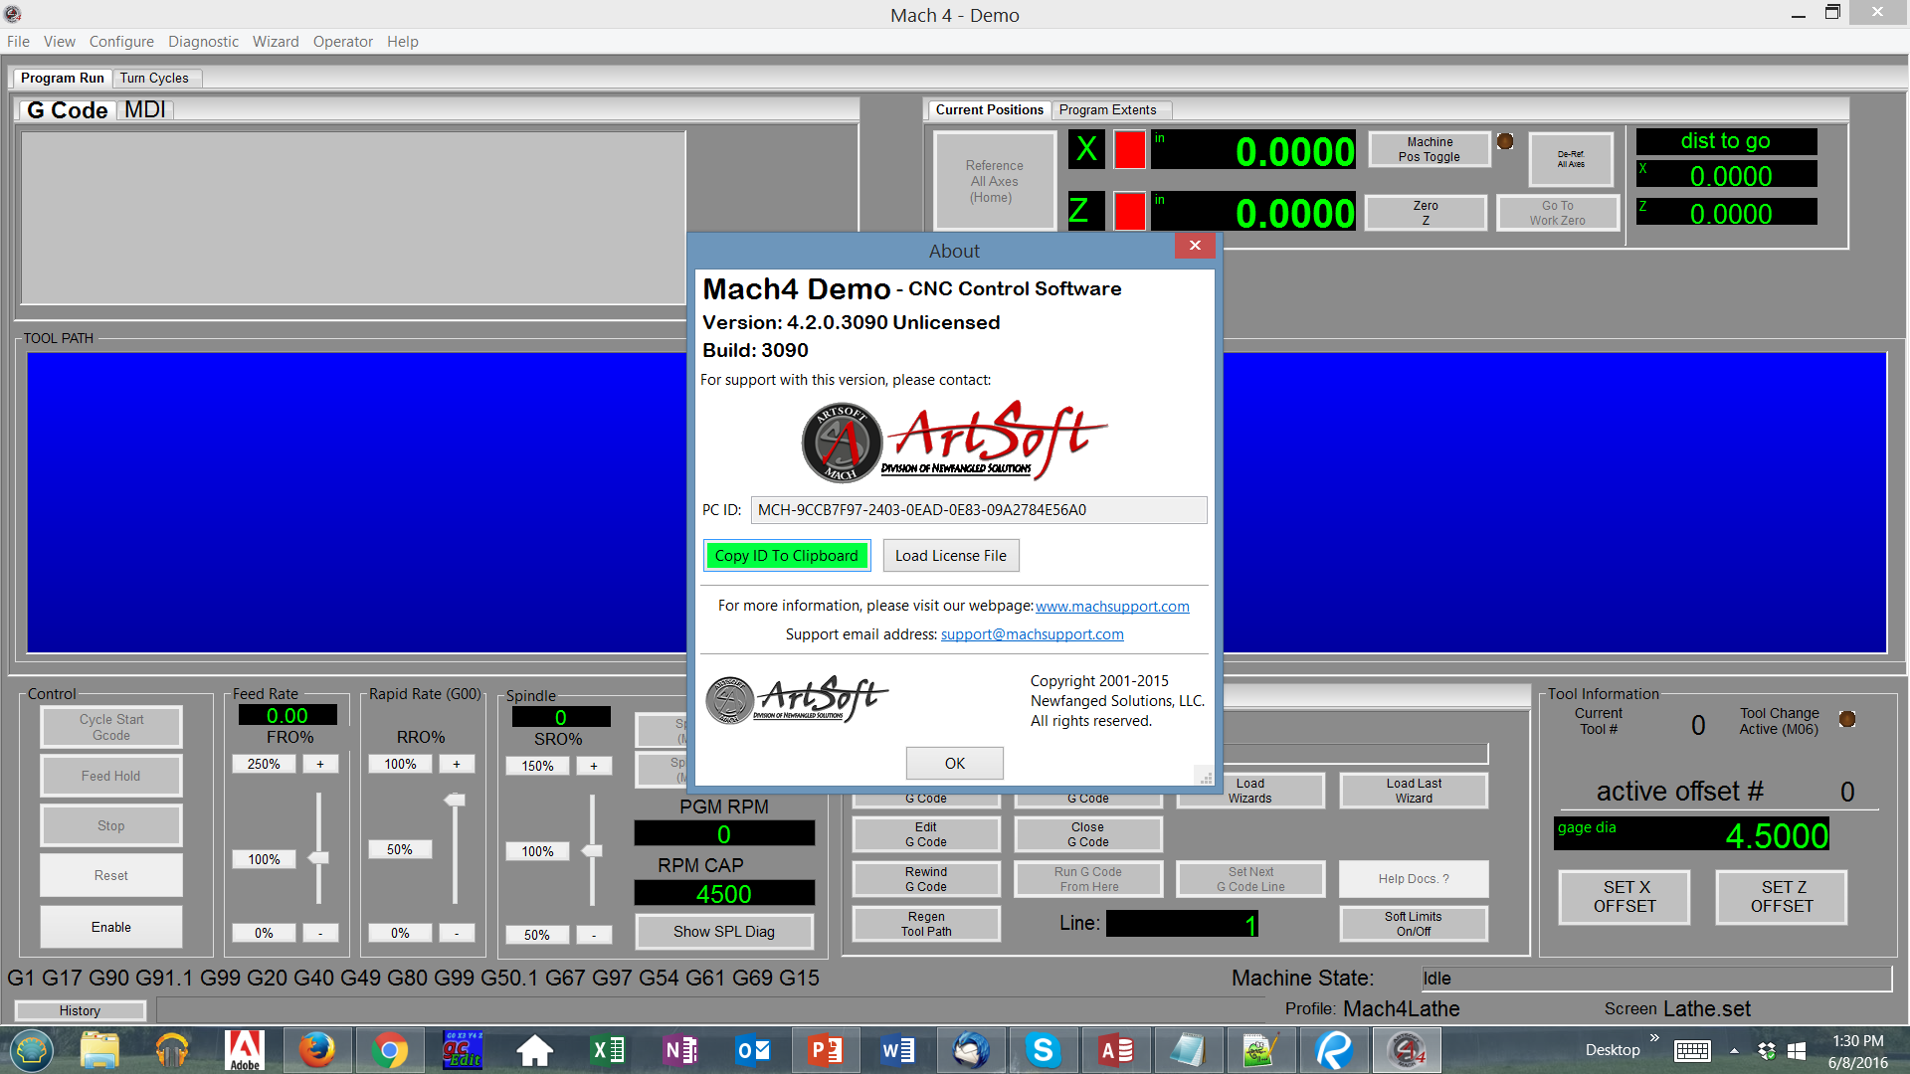
PC ID and location.
This is displayed by clicking the Help the About tabs

Slide 5
Use the Copy to Clipboard button to ensure that the PC ID is correct.

Slide 6
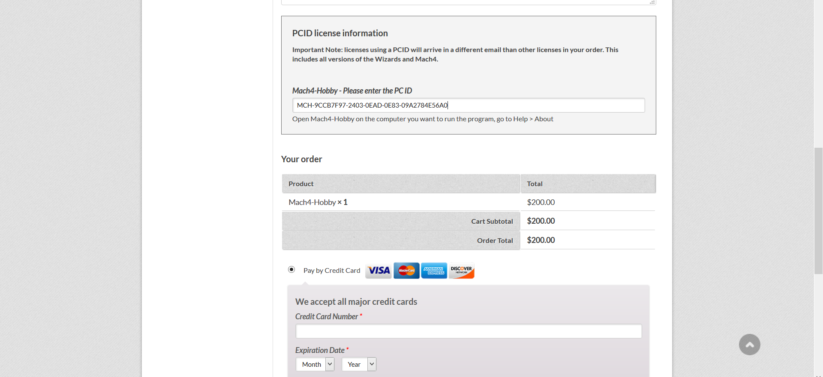
Paste the PC ID in the box when prompted.

Slide 7
After receiving the license file place it on your desktop or in a folder that is convenient.
Then click on the Load license file button and direct it to the license file.

Slide 8
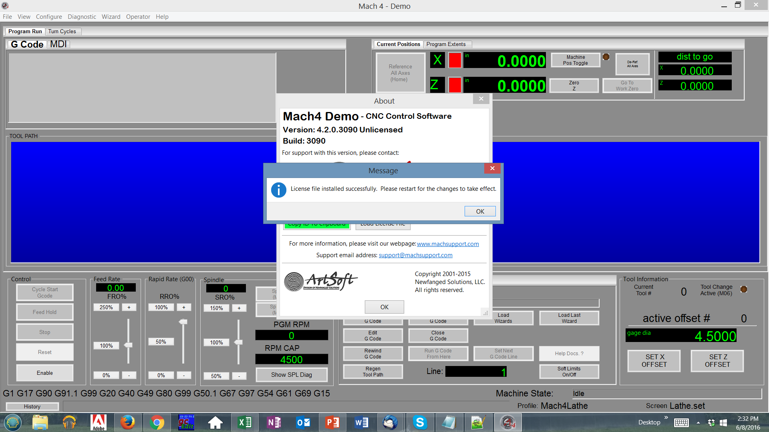
You will see a pop up message confirming license file was loaded.
Exit the software and when you reopen it you will be licensed.

Slide 9
License Maintenance:
When you purchase directly from ArtSoft through our website an account is created that will allow you to access and manage your license files at anytime.
Your user ID is the email address that you use to purchase the license file with.
Hardware and or even software (OS) changes will require a new license because that changes the PC ID.
You can generate up to 5 license files for hobby use only.

Slide 10
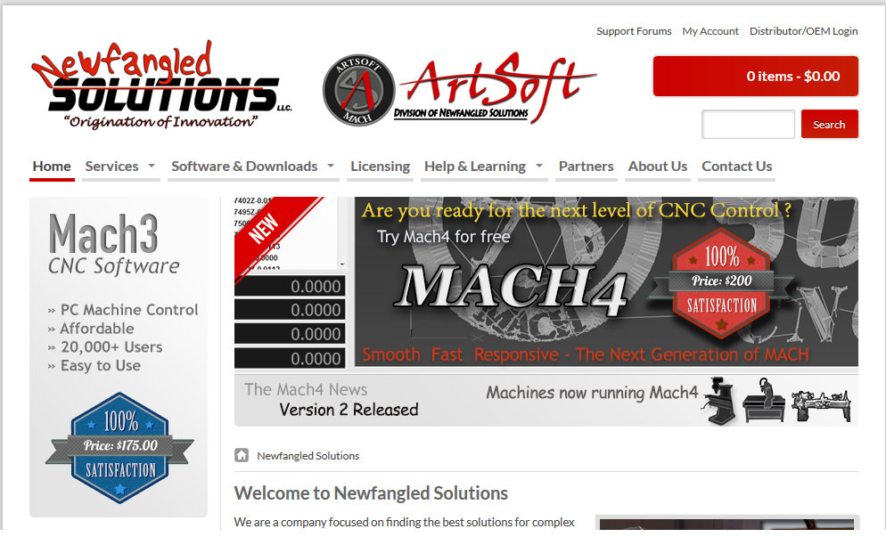
Accessing the license maintenance section of our website.

Slide 11
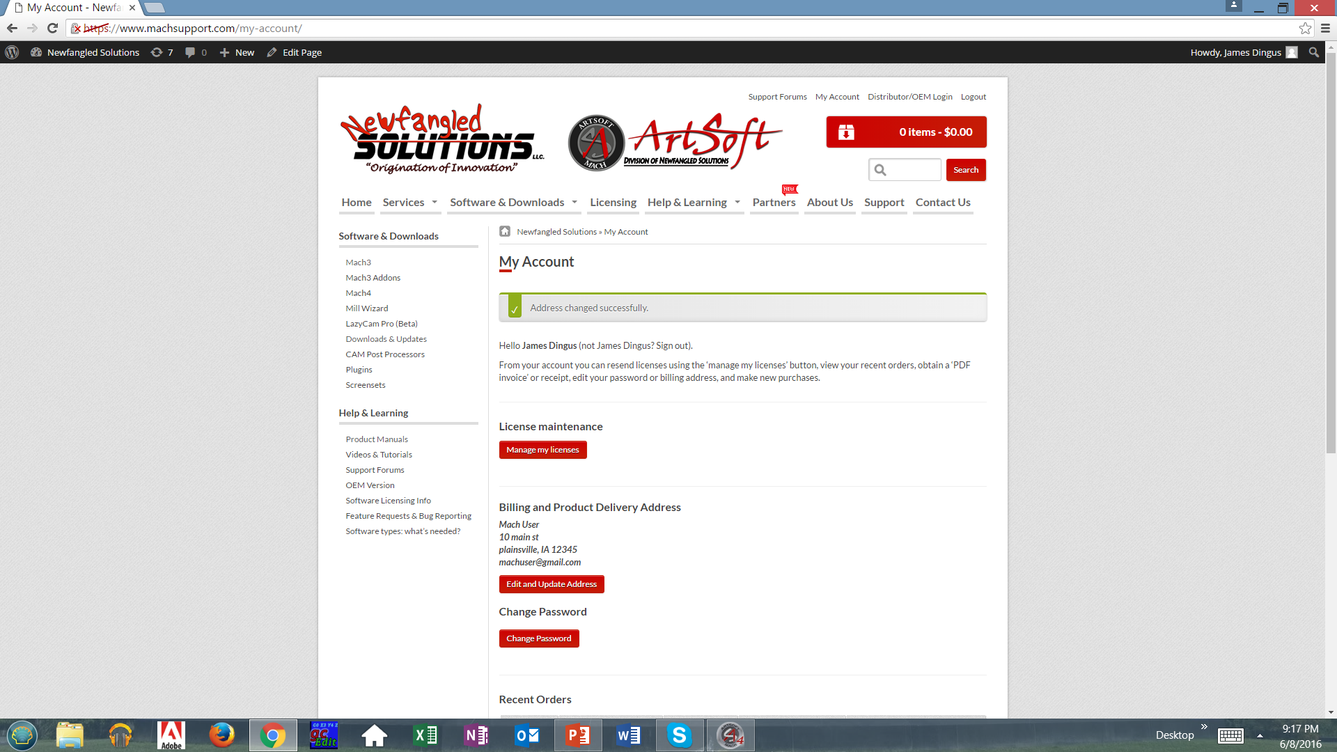
Clicking the manage license file button will allow you to modify or send replacement license files.

Slide 12
What is new and upcoming with Mach4
PMC -This new feature will allow users to create Lua scripting from a ladder logic diagram. Users will be able to start the spindle , coolant pumps. Set timers and map that to their custom machine set up and it will generate Lua scripting without user having to know how to program in Lua!
New Lathe specific screen set with Mach Motion canned cycles in screen.
New router specific screen set, with new touch module.

Slide 13
PMC
Programmable Mach Controller
This utility will allow users to be able to write a ladder logic diagram that the user can define and write within the PMC.
A basic knowledge of ladder logic is required.
The motion controller mapping is in the utility so you can assign predefined pins.
Intuitive and easier way to share between users and allows for complete editing and customization.
Has debugging feature, and status monitoring.

Slide 14
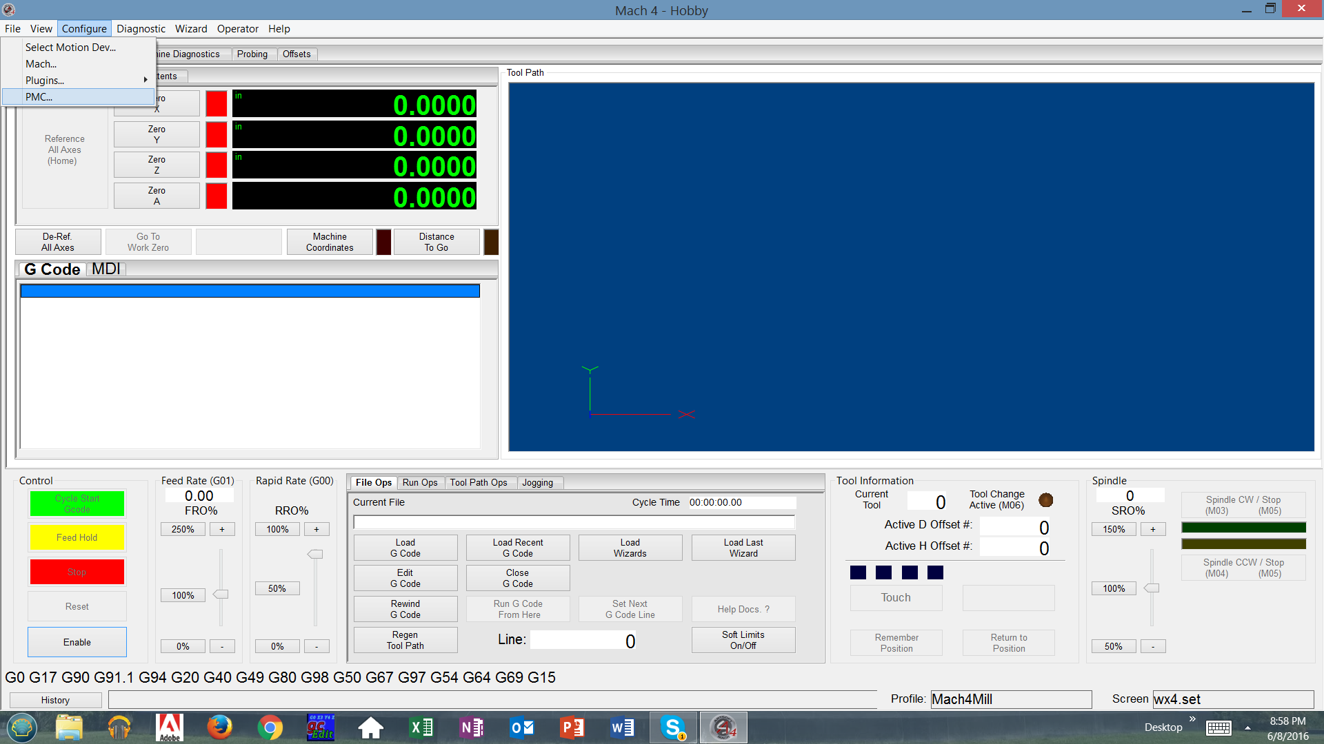
The PMC is accessed from the config tab.

Slide 15
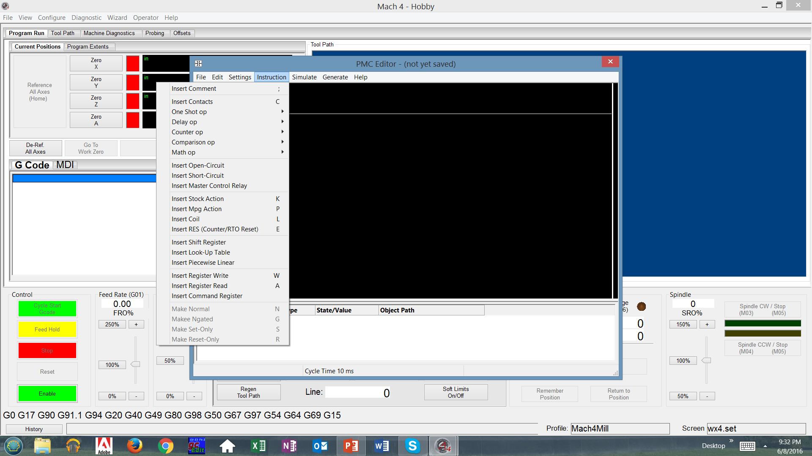
The instructions tab shows users the hot keys to create the ladder.

Slide 16
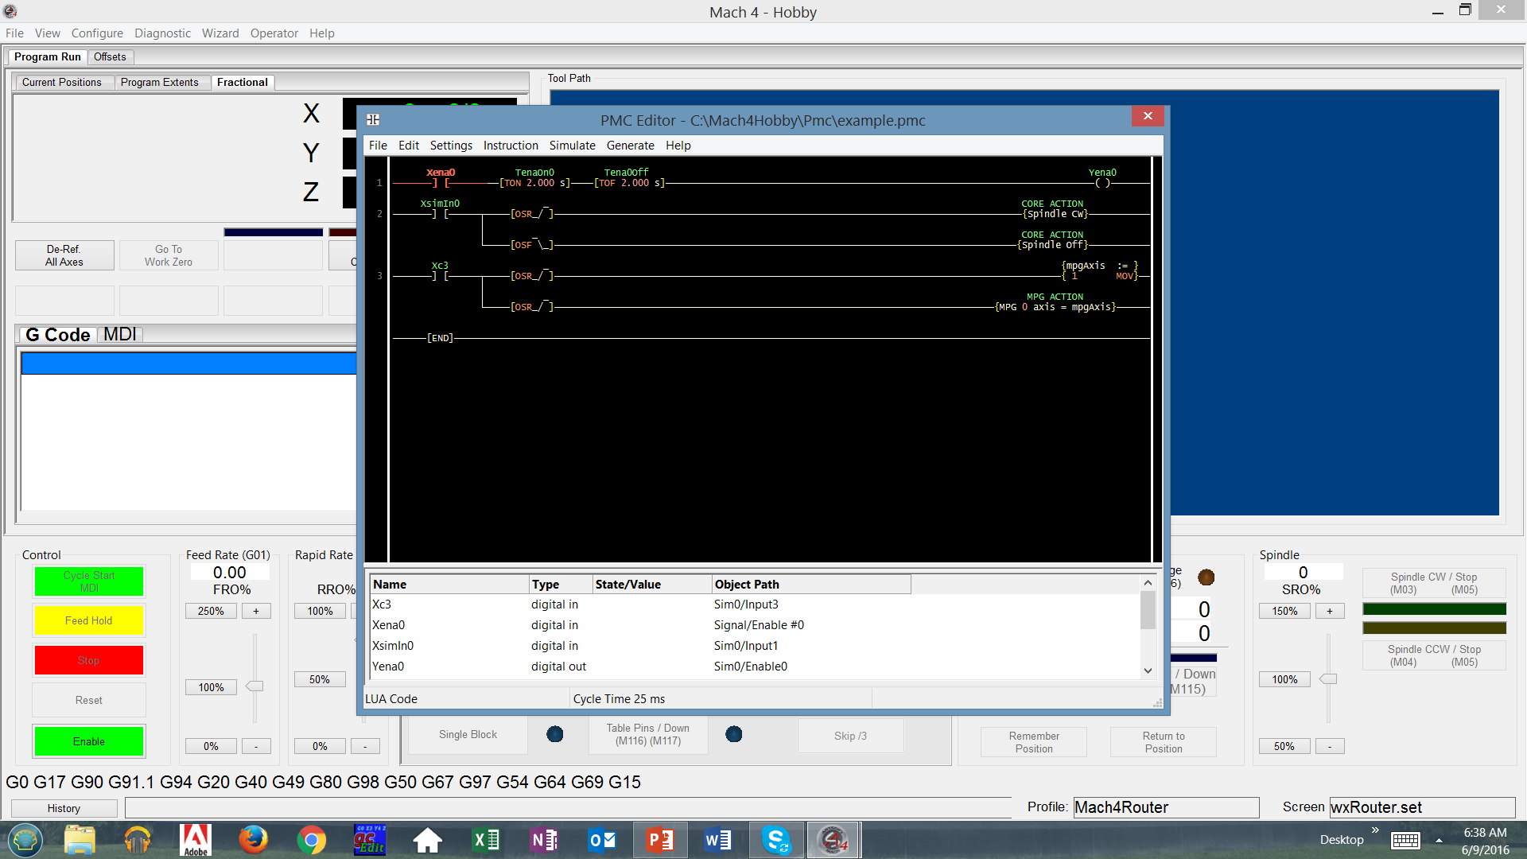
PMC example in ladder logic.

Slide 17
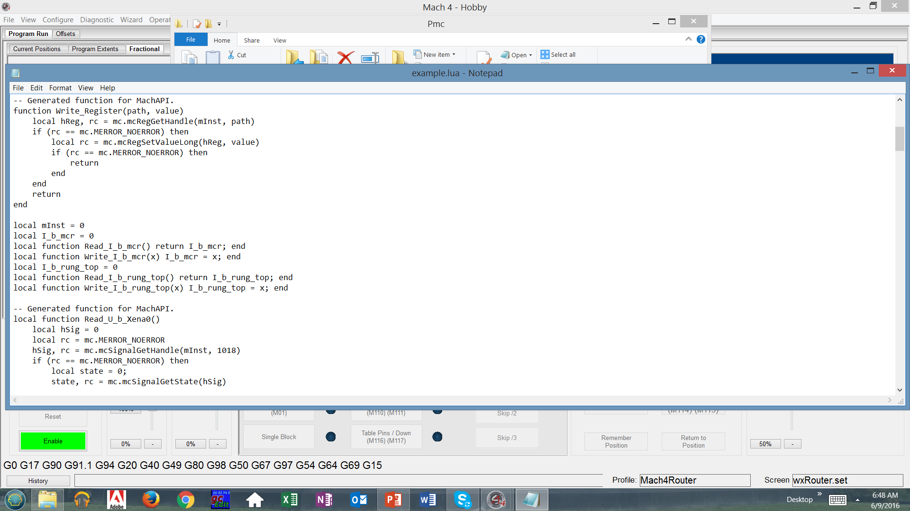
Lua script is then stored in Mach4 PMC folder.

Slide 18
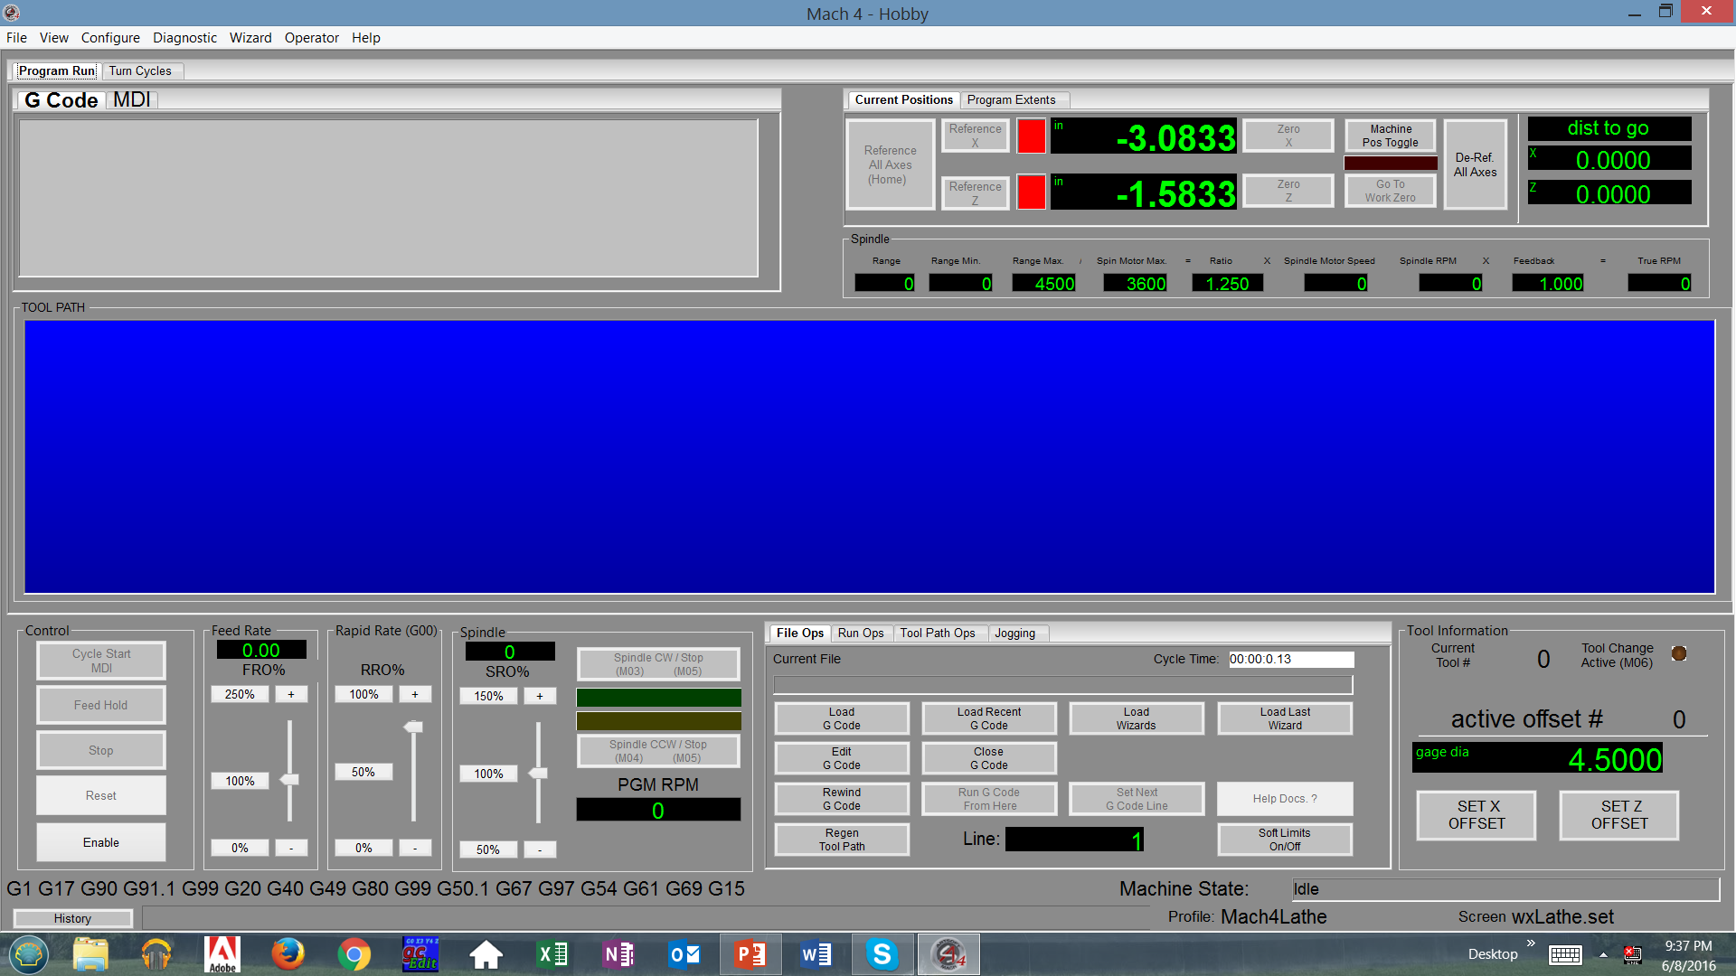
New Mach4 Lathe screen set!

Slide 19
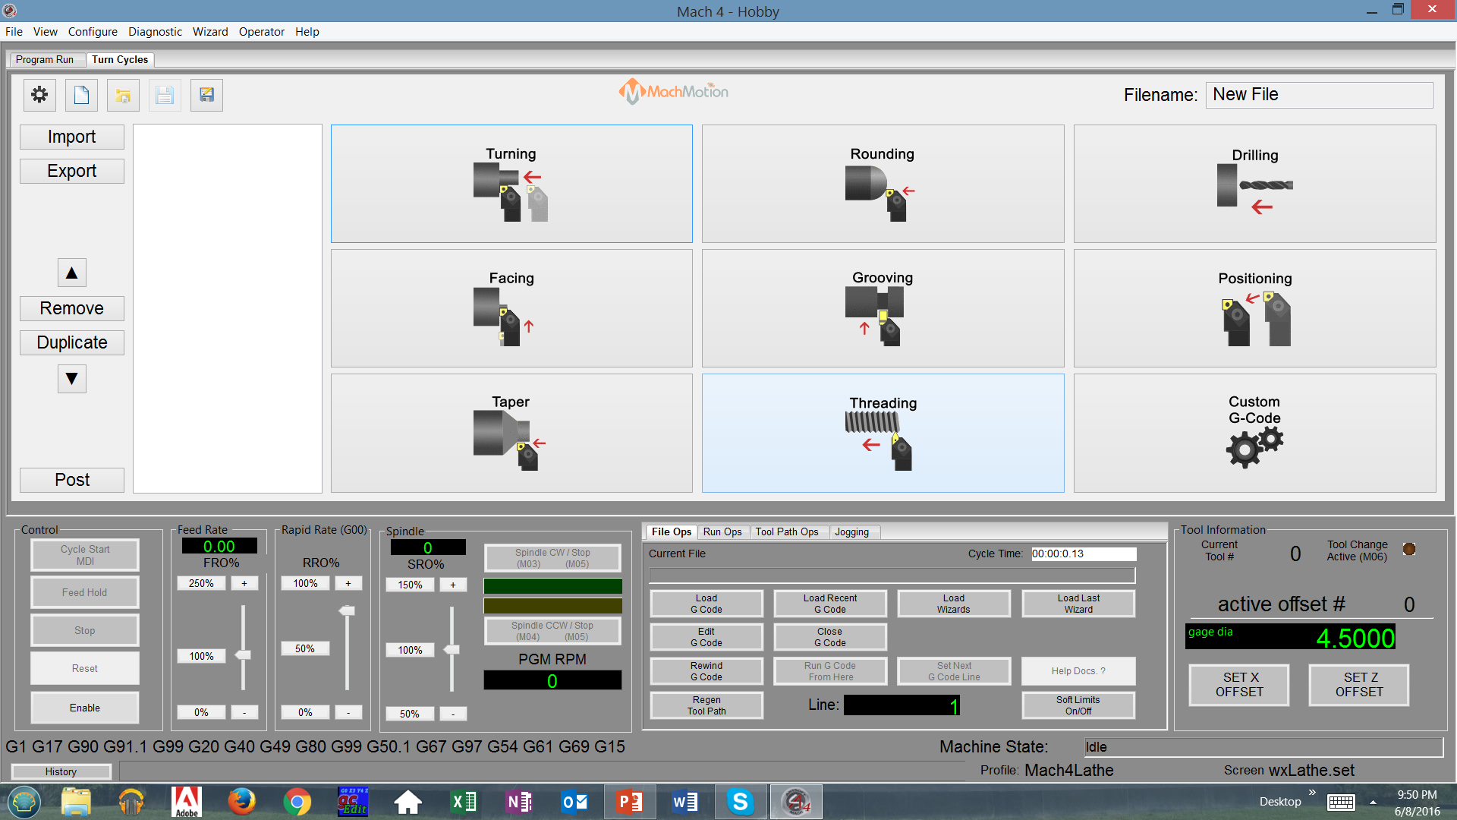
Common lathe cycle wizards built into screen donated by Mach Motion for hobby users.

Slide 20
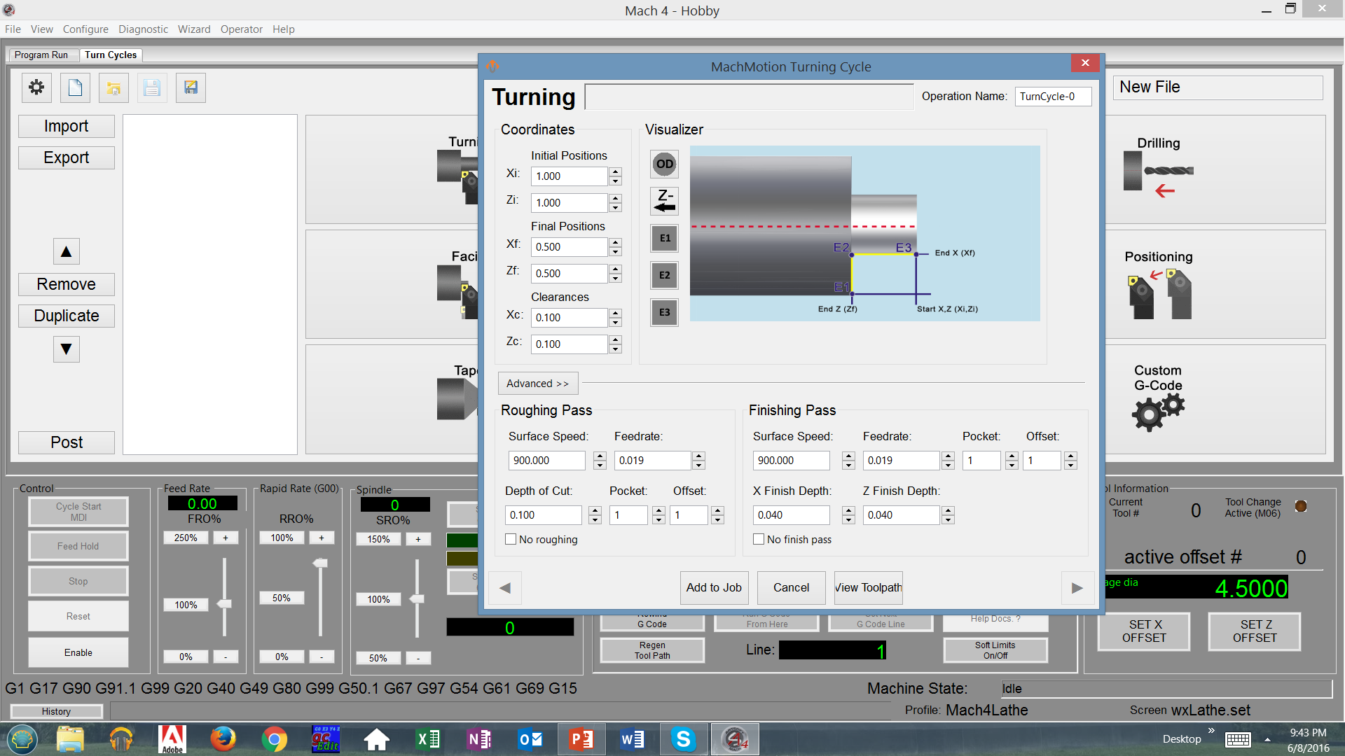
Users define the variables for the cycle.

Slide 21
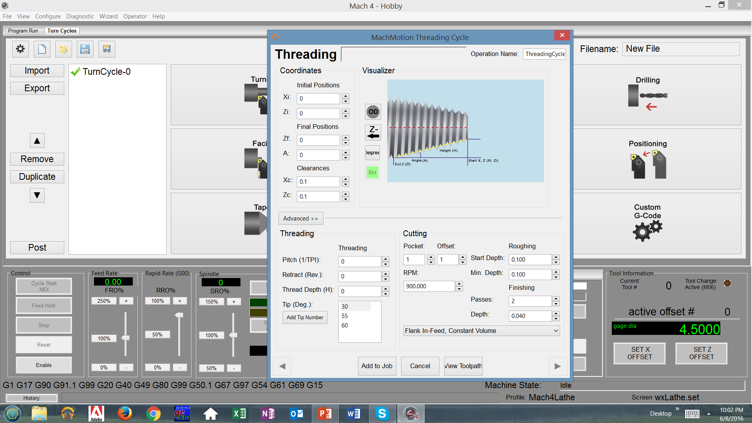
Threading cycle.

Slide 22
Router screen set features:
Dust hood/ down M114/M115 buttons.
Touch module incorporated into screen set.
Vacuum table M112/M113 on/off.
Table pins M116/M117 up/down.
Optional fractional DRO’s.

Slide 23
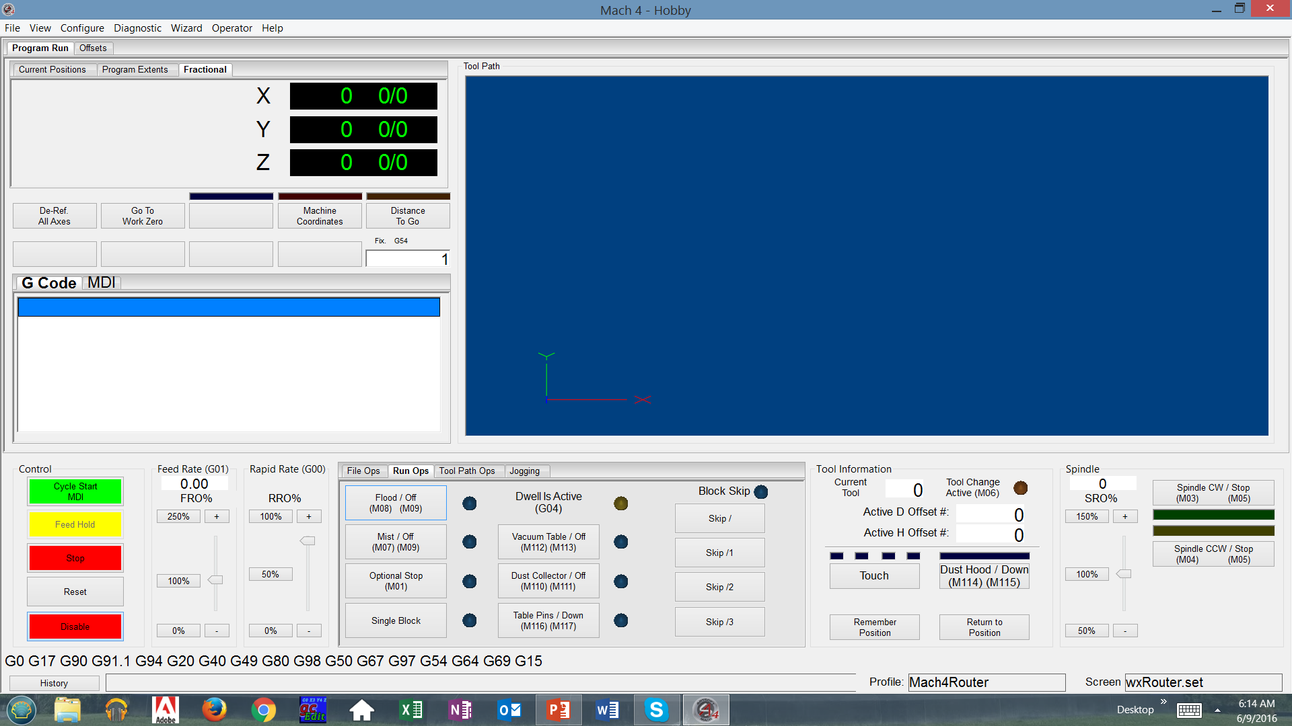
Router specific features and options.

Slide 24
Probing highlights:
Intuitive probing Icons.
Corner and bore probing.
Angle finder feature
Hoovering over buttons and features briefly opens a description of what the button does.
Ability to probe corners, (block must be same size in X,Y, Z planes).
Probing screen is written in lua and is open source.

Slide 25
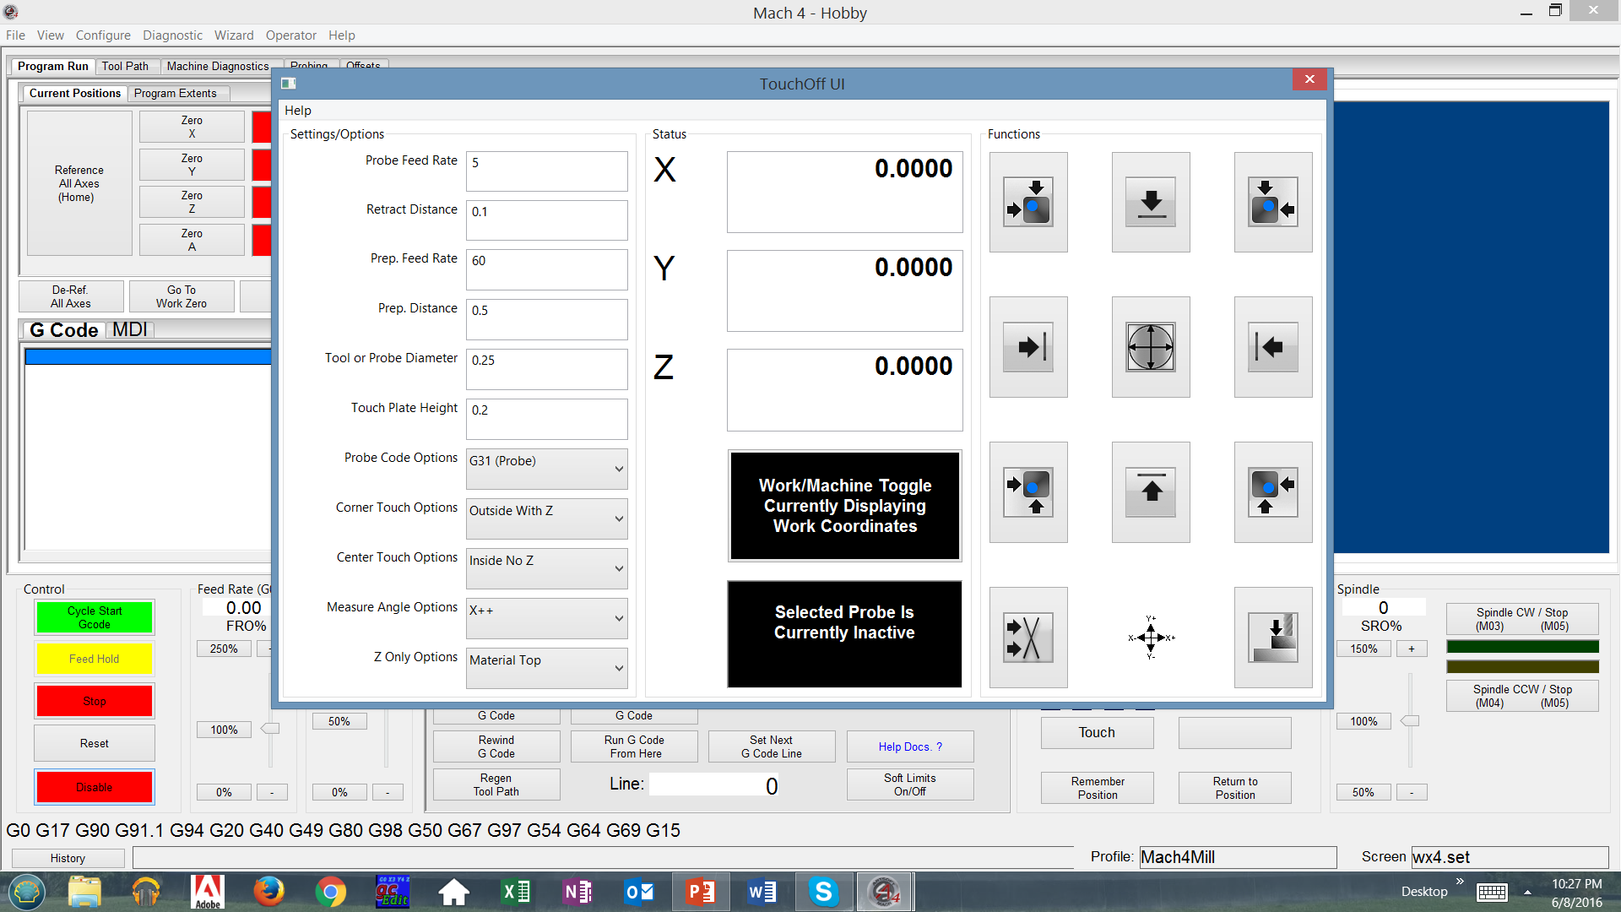
New touch module for mill/router probing.
It must be enabled and then click on touch:

